Slide 1


Database Lab Project
Trần Quang Hải 20194755
Nguyễn Hoàng Vũ 20190100
Nguyễn Ngọc Linh 20194790
Trần Hải Đăng 20194738

Slide 2

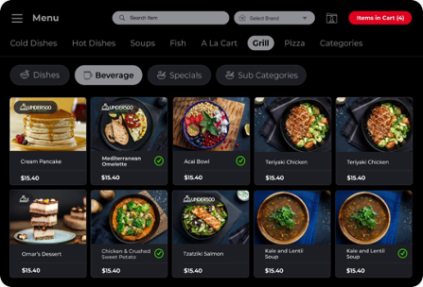
Restaurant Management App
The app was developed to help restaurant or café owners in managing the business.
See the need to frequently update the menu, stocks, and suppliers in the food industry, we created this app to understand the pragmatic usage of databases.

Slide 3


Who will use Our app
This app is designed for small business owners and entrepreneurs in the culinary industry.
Users can create a local database to keep track of their menu, stock, suppliers and use these data for financial analysis.

Slide 4



Tools
JavaFX: design, create, test, debug, and deploy client application using Java programming language
SQLite: store database locally for higher performance and faster query execution suitable for applications.

Slide 5
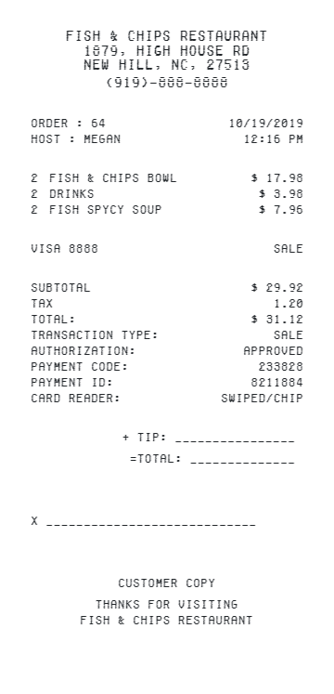

Design Process
An example bill of a restaurant.

Slide 6

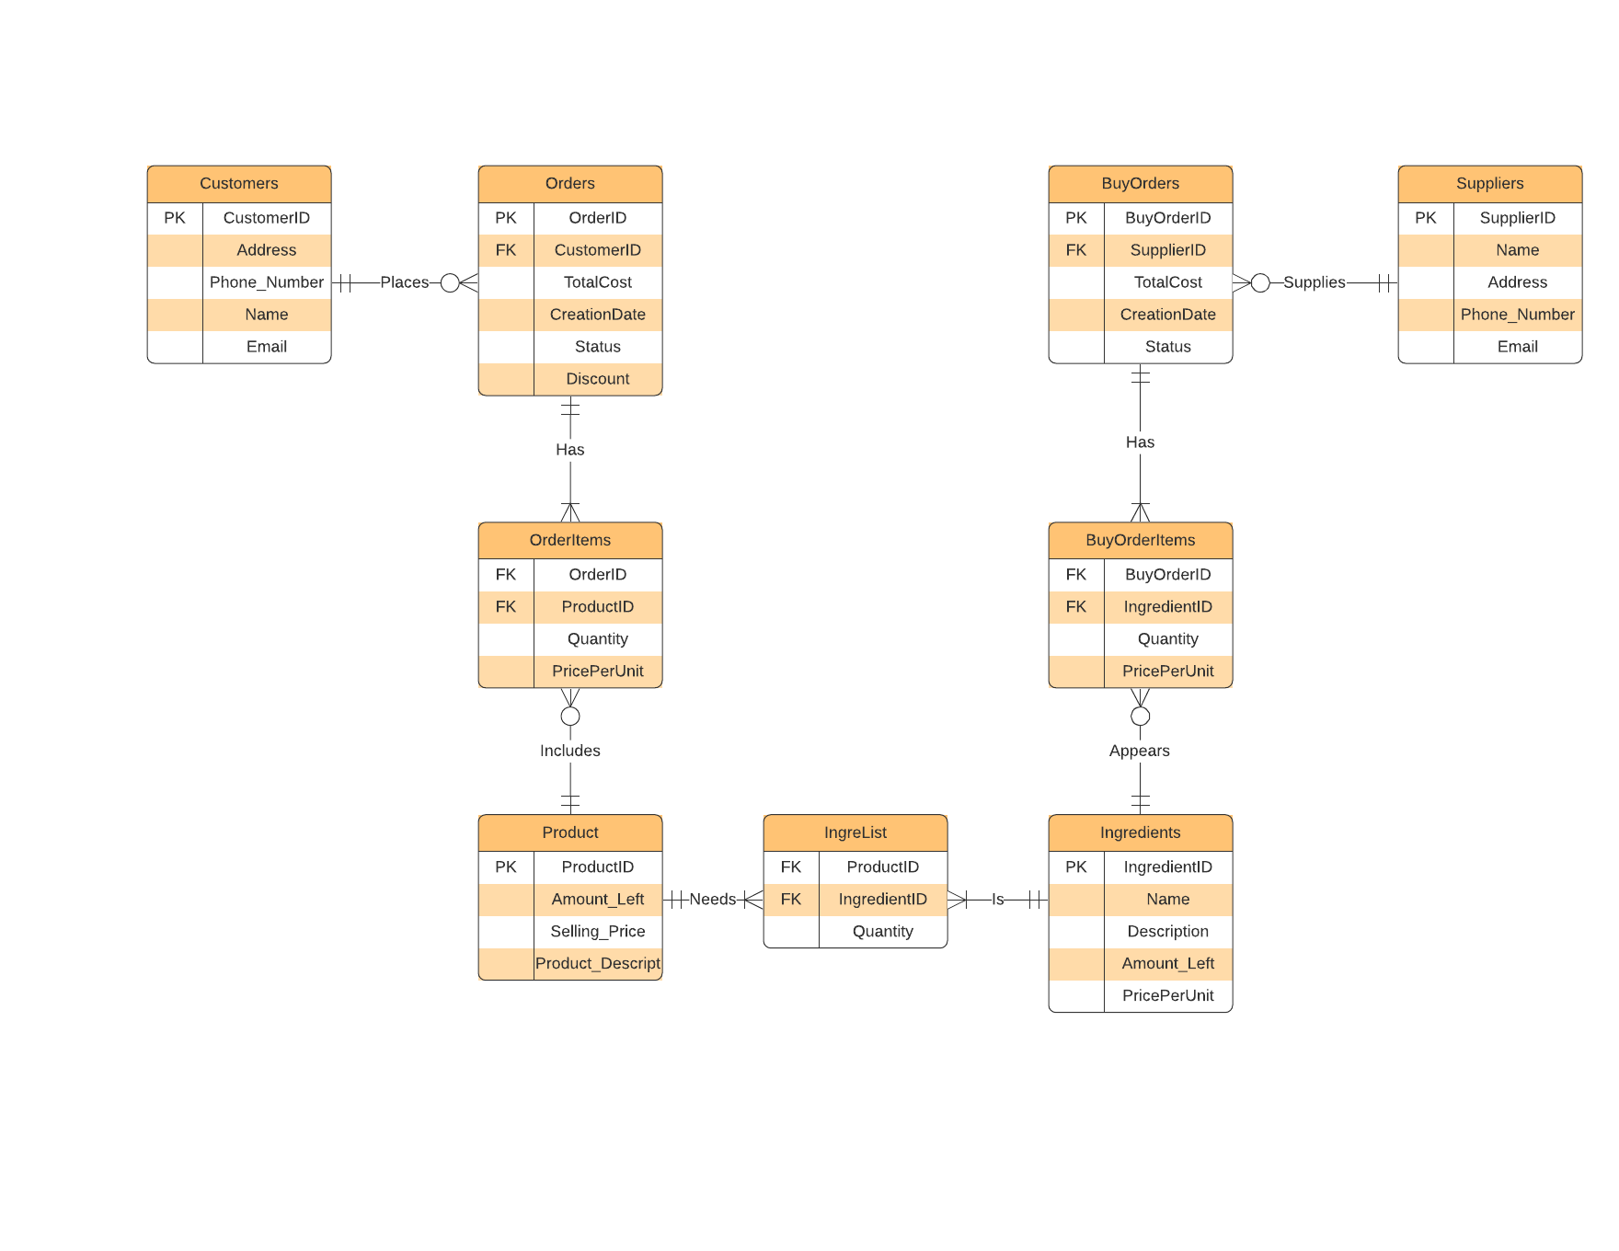
design process

Slide 7

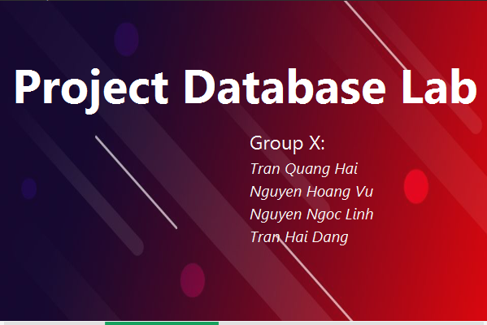
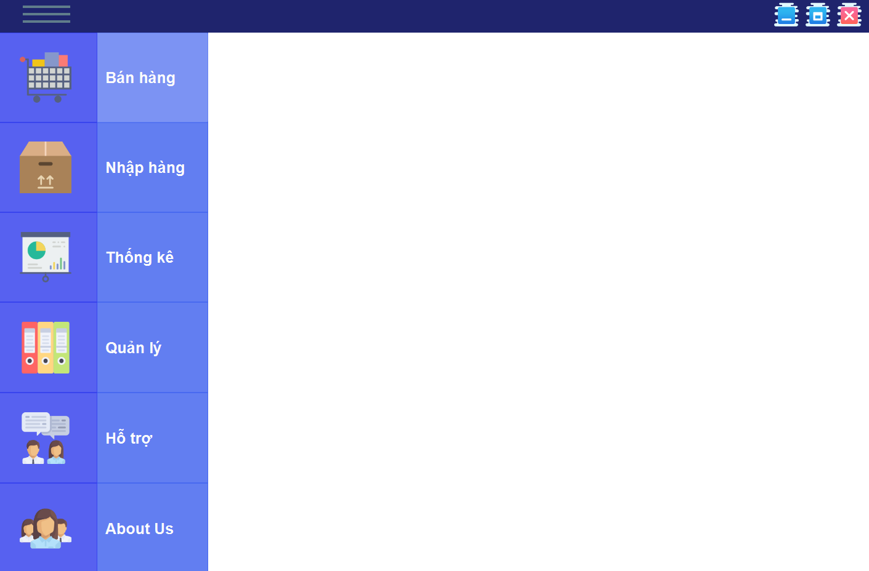
Application in Use
Loading screen
Main Menu

Slide 8
Thank you for listening
Comments & Question
welcome

